Slide 1
Physics 101: Mechanics Lecture 2
Dahiru Sanni
NUN Physics Department

Slide 2
Motion along a straight line
Motion
Position and displacement
Average velocity and average speed
Instantaneous velocity and speed
Acceleration
Constant acceleration: A special case
Free fall acceleration
Jan. 28-Feb. 1, 2013

Slide 3
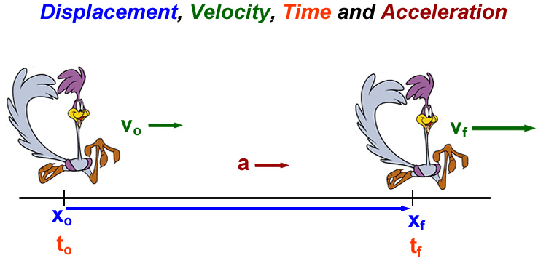
4 Basic Quantities in Kinematics
Jan. 28-Feb. 1, 2013

Slide 4
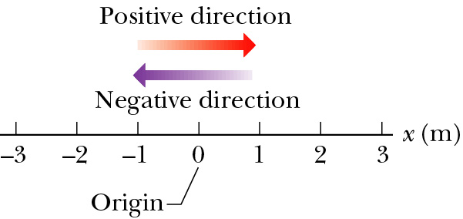
One Dimensional Position x
Motion can be defined as the change of position over time.
How can we represent position along a straight line?
Position definition:
  Defines a starting point: origin (x = 0), x relative to origin
  Direction: positive (right or up), negative (left or down)
  It depends on time: t = 0 (start clock), x(t=0) does not have to be zero.
Position has units of [Length]: meters.
x = + 2.5 m
x = - 3 m
Jan. 28-Feb. 1, 2013

Slide 5


Vector and Scalar
A vector quantity is characterized by having both a magnitude and a direction.
  Displacement, Velocity, Acceleration, Force …
  Denoted in boldface type or with an arrow over the top .
A scalar quantity has magnitude, but no direction.
  Distance, Mass, Temperature, Time …
For motion along a straight line, the direction is represented simply by + and – signs.
  + sign: Right or Up.
  − sign: Left or Down.
1-D motion can be thought of as a
component of 2-D and 3-D motions.
Jan. 28-Feb. 1, 2013

Slide 6
Quantities in Motion
Any motion involves three concepts
  Displacement
  Velocity
  Acceleration
These concepts can be used to study objects in motion.
Jan. 28-Feb. 1, 2013

Slide 7

Displacement
Displacement is a change of position in time.
Displacement:
  f stands for final and i stands for initial.
It is a vector quantity.
It has both magnitude and direction: + or − sign
It has units of [length]: meters.
x₁ (t₁) = + 2.5 m
x₂ (t₂) = - 2.0 m
Δx = -2.0 m - 2.5 m = -4.5 m
x₁ (t₁) = - 3.0 m
x₂ (t₂) = + 1.0 m
Δx = +1.0 m + 3.0 m = +4.0 m
Jan. 28-Feb. 1, 2013

Slide 8
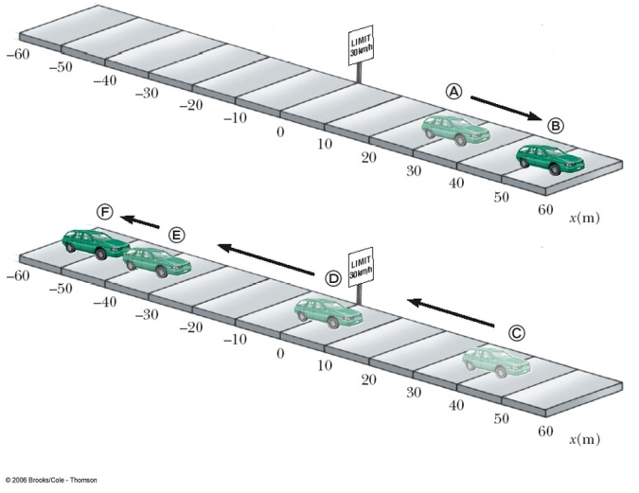
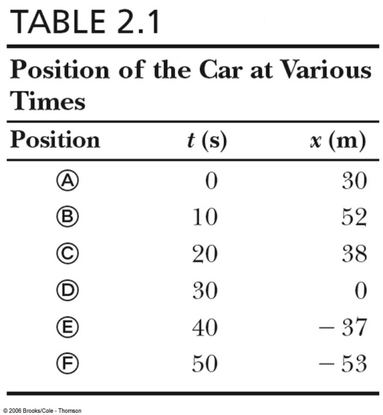
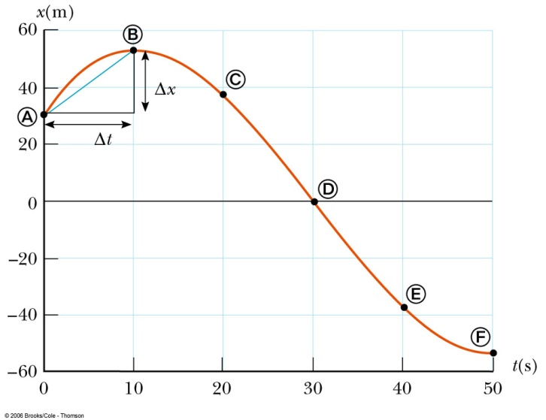
Distance and Position-time graph
Displacement in space
  From A to B: Δx = x_{B} – x_{A} = 52 m – 30 m = 22 m
  From A to C: Δx = x_{c} – x_{A} = 38 m – 30 m = 8 m
Distance is the length of a path followed by a particle
  from A to B: d = |x_{B} – x_{A}| = |52 m – 30 m| = 22 m
  from A to C: d = |x_{B} – x_{A}|+ |x_{C} – x_{B}| = 22 m + |38 m – 52 m| = 36 m
Displacement is not Distance.
Jan. 28-Feb. 1, 2013

Slide 9
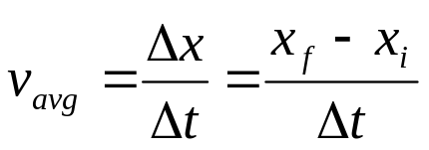
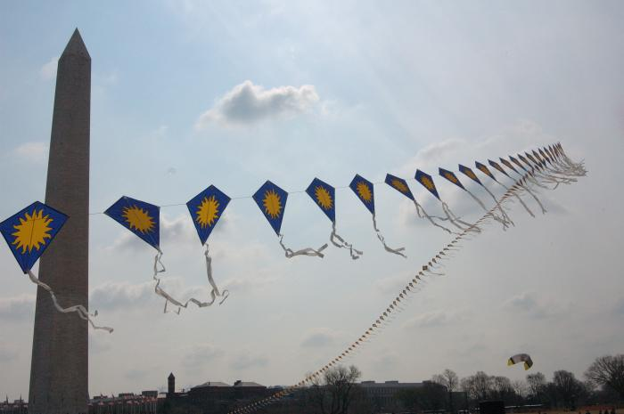
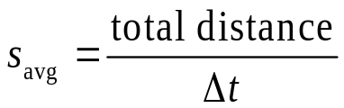
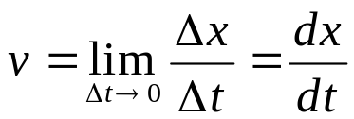
Velocity
Velocity is the rate of change of position.
Velocity is a vector quantity.
Velocity has both magnitude and direction.
Velocity has a unit of [length/time]: meter/second.
We will be concerned with three quantities, defined as:
  Average velocity
  Average speed
  Instantaneous
  velocity
displacement
distance
displacement
Jan. 28-Feb. 1, 2013

Slide 10
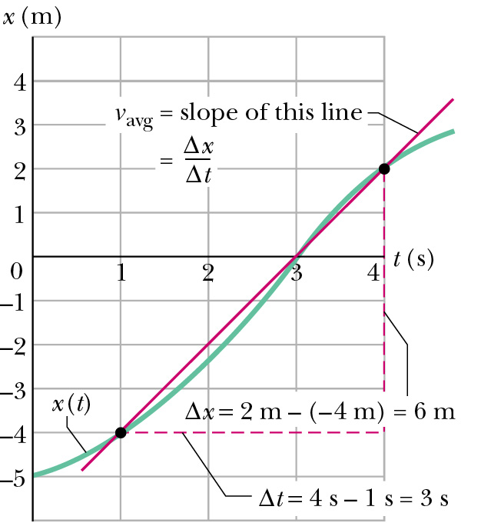
Average Velocity
Average velocity
is the slope of the line segment between end points on a graph.
Dimensions: length/time (L/T) [m/s].
SI unit: m/s.
It is a vector (i.e. is signed), and displacement direction sets its sign.
Jan. 28-Feb. 1, 2013

Slide 11
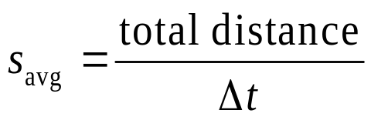
Average Speed
Average speed
Dimension: length/time, [m/s].
Scalar: No direction involved.
Not necessarily close to V_{avg}:
  S_{avg} = (6m + 6m)/(3s+3s) = 2 m/s
  V_{avg} = (0 m)/(3s+3s) = 0 m/s
Jan. 28-Feb. 1, 2013

Slide 12
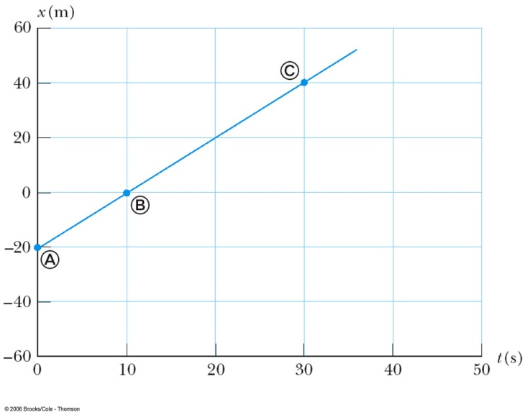
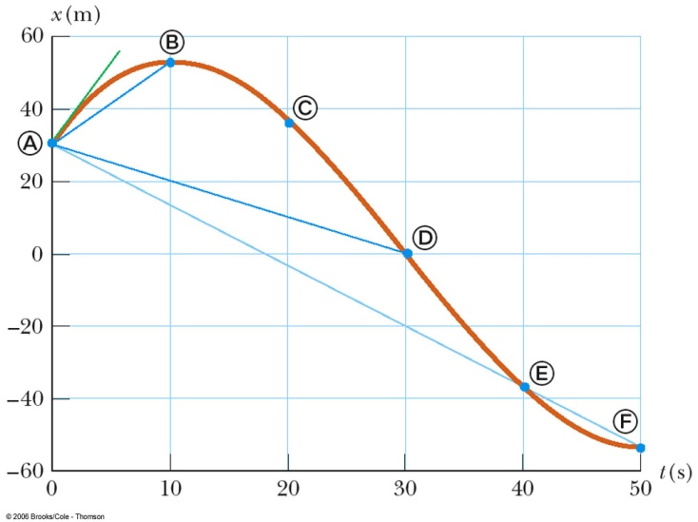
Graphical Interpretation of Velocity
Velocity can be determined from a position-time graph
Average velocity equals the slope of the line joining the initial and final positions. It is a vector quantity.
An object moving with a constant velocity will have a graph that is a straight line.
Jan. 28-Feb. 1, 2013

Slide 13
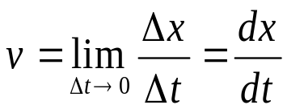
Instantaneous Velocity
Instantaneous means “at some given instant”. The instantaneous velocity indicates what is happening at every point of time.
Limiting process:
  Chords approach the tangent as Δt => 0
  Slope measure rate of change of position
Instantaneous velocity:
It is a vector quantity.
Dimension: length/time (L/T), [m/s].
It is the slope of the tangent line to x(t).
Instantaneous velocity v(t) is a function of time.
Jan. 28-Feb. 1, 2013

Slide 14
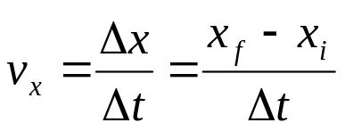

Uniform Velocity
Uniform velocity is the special case of constant velocity
In this case, instantaneous velocities are always the same, all the instantaneous velocities will also equal the average velocity
Begin with then
x
v
Note: we are plotting velocity vs. time
x(t)
v(t)
x_{f}
v_{x}
x_{i}
0
t
0
t
t_{i}
t_{f}
Jan. 28-Feb. 1, 2013

Slide 15
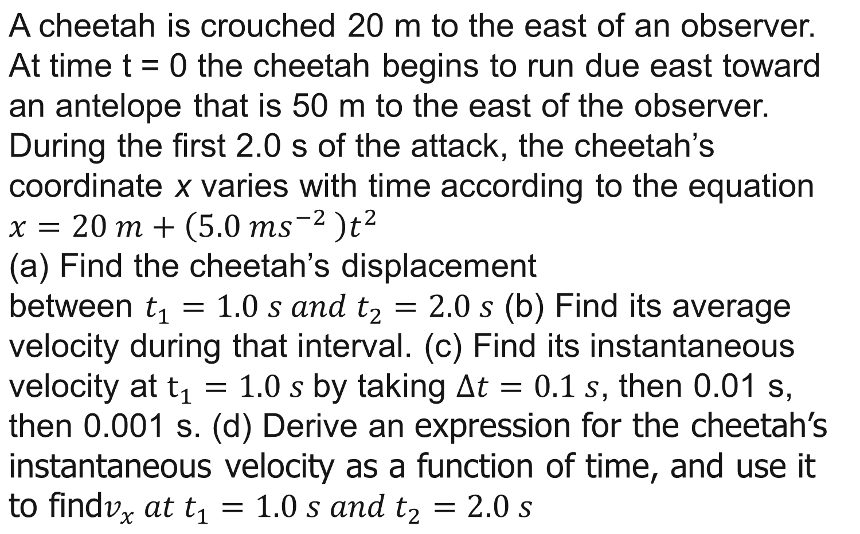
Example 1
Jan. 28-Feb. 1, 2013

Slide 16
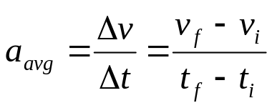
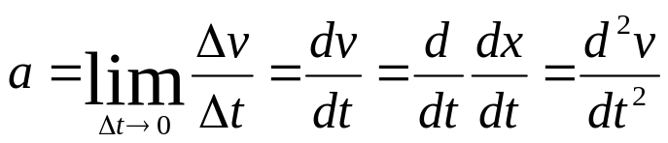
Average Acceleration
Changing velocity (non-uniform) means an acceleration is present.
Acceleration is the rate of change of velocity.
Acceleration is a vector quantity.
Acceleration has both magnitude and direction.
Acceleration has a dimensions of length/time²: [m/s²].
Definition:
  Average acceleration
  Instantaneous acceleration
Jan. 28-Feb. 1, 2013

Slide 17
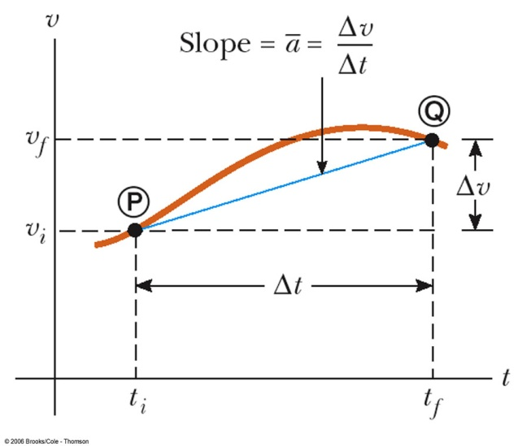

Average Acceleration
Note: we are plotting velocity vs. time
Average acceleration
Velocity as a function of time
It is tempting to call a negative acceleration a “deceleration,” but note:
  When the sign of the velocity and the acceleration are the same (either positive or negative), then the speed is increasing
  When the sign of the velocity and the acceleration are in the opposite directions, the speed is decreasing
Average acceleration is the slope of the line connecting the initial and final velocities on a velocity-time graph
Jan. 28-Feb. 1, 2013

Slide 18
Instantaneous and Uniform Acceleration
The limit of the average acceleration as the time interval goes to zero
When the instantaneous accelerations are always the same, the acceleration will be uniform. The instantaneous acceleration will be equal to the average acceleration
Instantaneous acceleration is the
slope of the tangent to the curve
of the velocity-time graph
Jan. 28-Feb. 1, 2013

Slide 19
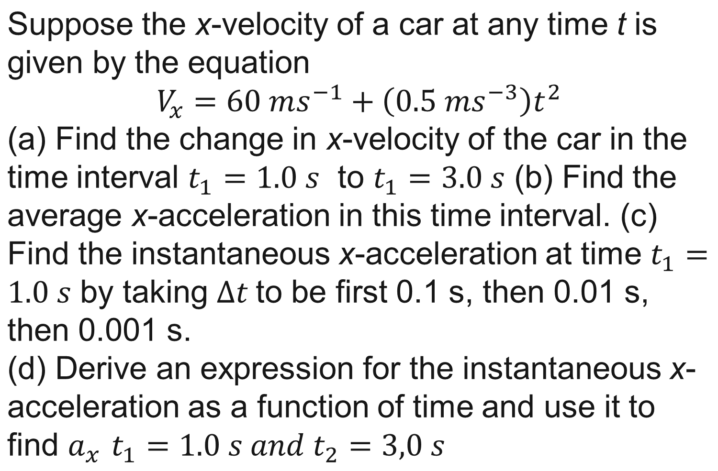
Example 2
Jan. 28-Feb. 1, 2013

Slide 20
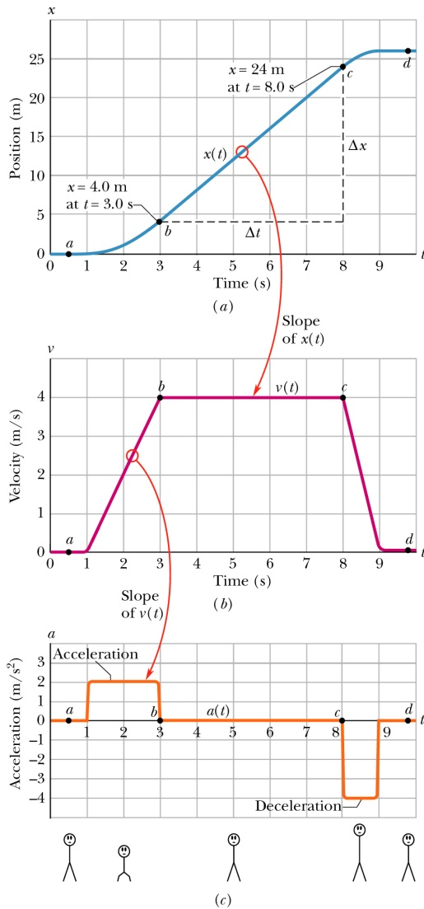

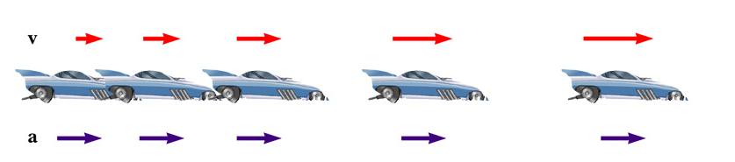
Relationship between Acceleration and Velocity (First Stage)
Velocity and acceleration are in the same direction
Acceleration is uniform (blue arrows maintain the same length)
Velocity is increasing (red arrows are getting longer)
Positive velocity and positive acceleration
Jan. 28-Feb. 1, 2013

Slide 21
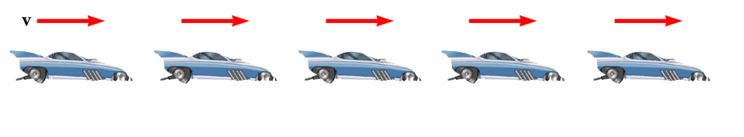
Relationship between Acceleration and Velocity (Second Stage)
Uniform velocity (shown by red arrows maintaining the same size)
Acceleration equals zero
Jan. 28-Feb. 1, 2013

Slide 22
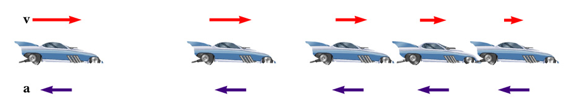
Relationship between Acceleration and Velocity (Third Stage)
Acceleration and velocity are in opposite directions
Acceleration is uniform (blue arrows maintain the same length)
Velocity is decreasing (red arrows are getting shorter)
Velocity is positive and acceleration is negative
Jan. 28-Feb. 1, 2013

Slide 23

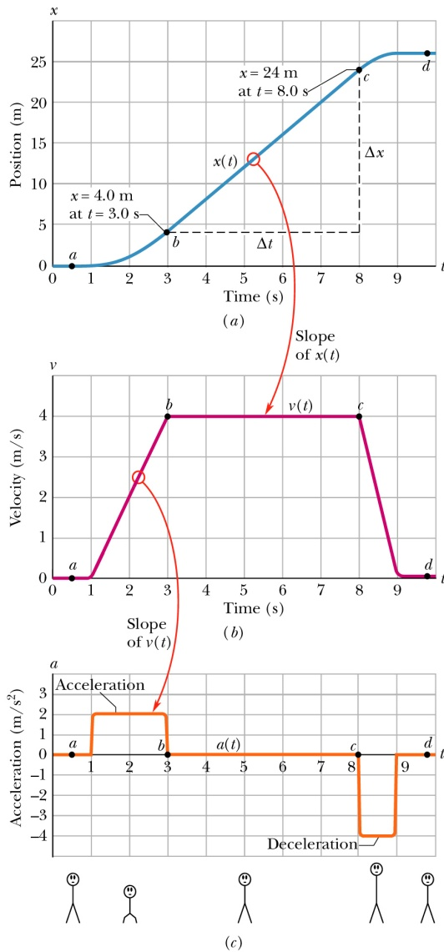
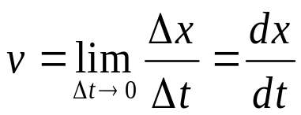
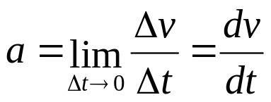

Kinematic Variables: x, v, a
Position is a function of time:
Velocity is the rate of change of position.
Acceleration is the rate of change of velocity.
Position Velocity Acceleration
Graphical relationship between x, v, and a
This same plot can apply to an elevator that is initially stationary, then moves upward, and then stops. Plot v and a as a function of time.
Jan. 28-Feb. 1, 2013

Slide 24
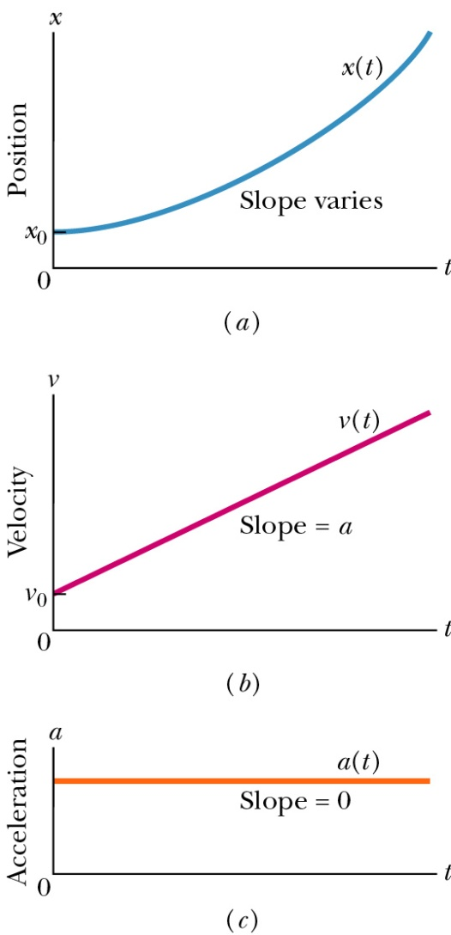
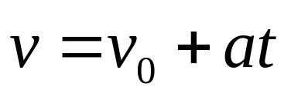
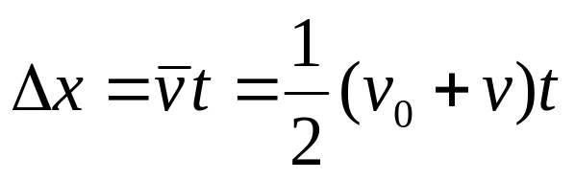
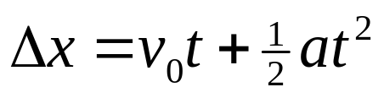
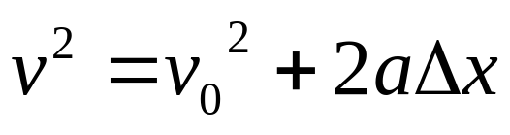
Special Case: Motion with Uniform Acceleration (our typical case)
Acceleration is a constant
Kinematic Equations (which we will derive in a moment)
Jan. 28-Feb. 1, 2013

Slide 25
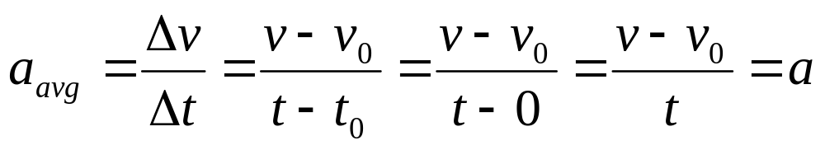
Derivation of the Equation (1)
Given initial conditions:
  a(t) = constant = a, v(t = 0) = v₀, x(t = 0) = x₀
Start with definition of average acceleration:
We immediately get the first equation
Shows velocity as a function of acceleration and time
Use when you don’t know and aren’t asked to find the displacement
Jan. 28-Feb. 1, 2013

Slide 26
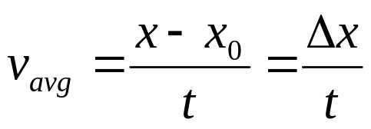
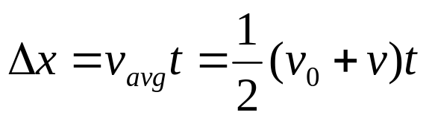
Derivation of the Equation (2)
Given initial conditions:
  a(t) = constant = a, v(t = 0) = v₀, x(t = 0) = x₀
Start with definition of average velocity:
Since velocity changes at a constant rate, we have
Gives displacement as a function of velocity and time
Use when you don’t know and aren’t asked for the acceleration
Jan. 28-Feb. 1, 2013

Slide 27

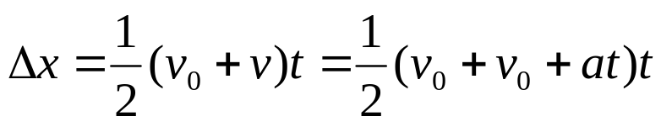
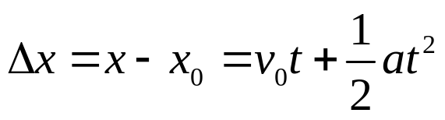
Derivation of the Equation (3)
Given initial conditions:
  a(t) = constant = a, v(t = 0) = v₀, x(t = 0) = x₀
Start with the two just-derived equations:
We have
Gives displacement as a function of all three quantities: time, initial velocity and acceleration
Use when you don’t know and aren’t asked to find the final velocity
Jan. 28-Feb. 1, 2013

Slide 28
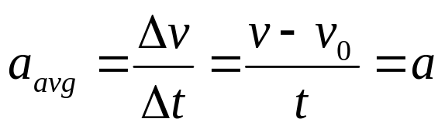
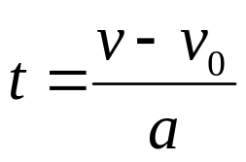
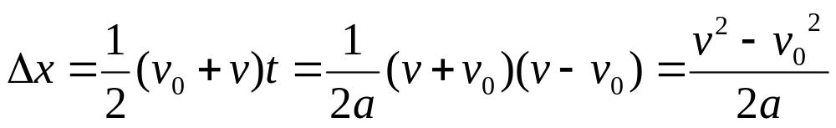
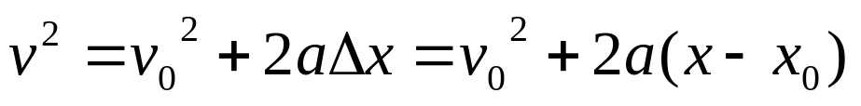
Derivation of the Equation (4)
Given initial conditions:
  a(t) = constant = a, v(t = 0) = v₀, x(t = 0) = x₀
Rearrange the definition of average acceleration
, to find the time
Use it to eliminate t in the second equation:
, rearrange to get
Gives velocity as a function of acceleration and displacement
Use when you don’t know and aren’t asked for the time
Jan. 28-Feb. 1, 2013

Slide 29
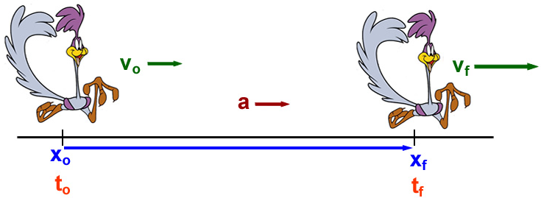



Problem-Solving Hints
Read the problem
Draw a diagram
  Choose a coordinate system, label initial and final points, indicate a positive direction for velocities and accelerations
Label all quantities, be sure all the units are consistent
  Convert if necessary
Choose the appropriate kinematic equation
Solve for the unknowns
  You may have to solve two equations for two unknowns
Check your results
Jan. 28-Feb. 1, 2013
Notes:
The best way to gain confidence in the use of these equations is to work a number of problems. The following procedure is recommended for solving problems involving acceleration motion.

Slide 30
Example
An airplane has a lift-off speed of 30 m/s after a take-off run of 300 m, what minimum constant acceleration?
What is the corresponding take-off time?
Jan. 28-Feb. 1, 2013
Notes:
The best way to gain confidence in the use of these equations is to work a number of problems. The following procedure is recommended for solving problems involving acceleration motion.

Slide 31
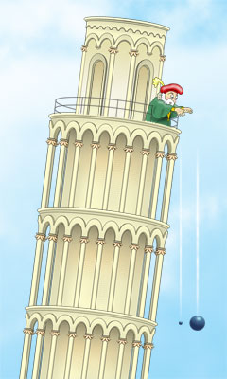
Free Fall Acceleration
y
Earth gravity provides a constant acceleration. Most important case of constant acceleration.
Free-fall acceleration is independent of mass.
Magnitude: |a| = g = 9.8 m/s²
Direction: always downward, so a_{g} is negative if we define “up” as positive,
a = −g = −9.8 m/s²
Try to pick origin so that x_{i} = 0
Jan. 28-Feb. 1, 2013

Slide 32
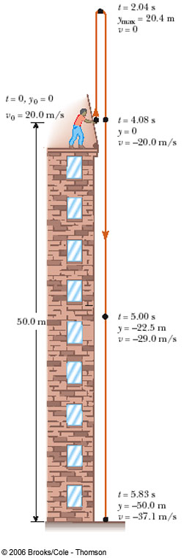
Free Fall for Rookie
A stone is thrown from the top of a building with an initial velocity of 20.0 m/s straight upward, at an initial height of 50.0 m above the ground. The stone just misses the edge of the roof on the its way down. Determine
(a) the time needed for the stone to reach its maximum height.
(b) the maximum height.
(c) the time needed for the stone to return to the height from which it was thrown and the velocity of the stone at that instant.
(d) the time needed for the stone to reach the ground
(e) the velocity and position of the stone at t = 5.00s
Jan. 28-Feb. 1, 2013

Slide 33





Summary
This is the simplest type of motion
It lays the groundwork for more complex motion
Kinematic variables in one dimension
  Position x(t) m L
  Velocity v(t) m/s L/T
  Acceleration a(t) m/s² L/T²
  All depend on time
  All are vectors: magnitude and direction vector:
Equations for motion with constant acceleration: missing quantities
  x – x₀
  v
  t
  a
  v₀
Jan. 28-Feb. 1, 2013

